Slide 1
Humanities and Social Sciences Faculty Meeting
11 April 2017

Slide 2
Overview
This year’s budget
Next year’s budget
“Right sizing” our college
Let’s remember why we are here….

Slide 3
Closing FY 16-17
The college is $100K-$200K short
We will close the books with a $0 balance by…
  Saving whatever we can (If you have unspent money, we need it!)
  Exhausting F&A in units that are short
  Aggressively moving expenses to gift funds where allowed/appropriate
We’ll make it through this year… but what about next?

Slide 4
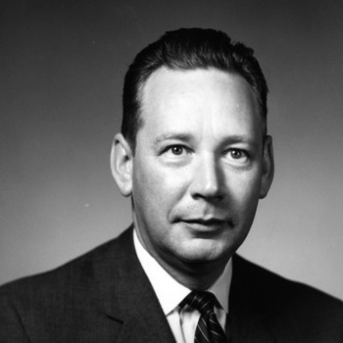
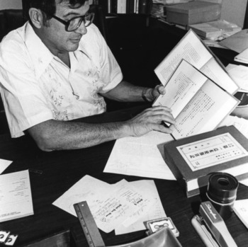
Next Year’s (FY17-18) Budget
Dean Tillman: “The days of easy money are over!”
Dean Cahill: “We’re cutting our budget again this year.”

Slide 5


Slide 6
The Big Picture
University will return $11.6M (w/ no additional cuts)
  Why? We missed our 12-cell matrix projections
  12-cell matrix linked to enrollment; we over-estimated
Provost will divide his $7.1M reduction as follows:
  $4.6M reserves (this year only)
  $2.5M academic units capped at < 1% of base
Our college’s share:
  -$789,874 in SCH funding FY 17-18 (we went under)
  +$676,590 in SCH funding FY 18-19 (we hit targets)
  But: provost shares 50% of change, + 1% cap =
  -$353,381 for our college FY 17-18
  +$296,752 for our college FY 18-19

Slide 7
Are we Ready for Winter?
Dean’s reserve for FY17-18 = $500K
  $353,381 goes back to provost 1 July
  $10,598 goes back to provost/GA for retention funds of faculty who resigned or retired
  $142,684 goes to departments for new commitments
    Targets of opportunity, retentions, spousal accommodations, etc.
  Leaves us -$6K entering this year
Implications:
  No “float”
  Funds for new hires not guaranteed (depends on enrollment and resignations/retirements)

Slide 9


Slide 10


Slide 11


Slide 12
Right-Sizing Our College

Slide 13
Principles to Drive Allocations
Funding for departments should be at/near the college mean for 12-cell matrix $
Example for Dept. X
  12-cell funding formula generates $5M (15-16 SCH)
  FY16-17 expenditures $4.5M
  Dept. funding = 90% of expenditures
  College average = 90% of expenditures
  Dept. X is at college average
  Therefore, FY17-18 budget remains the same (no change)

Slide 14
Funding Ratios for College Departments
FY16-17 Expenditures/12-Cell SCH $

Slide 15
Strategies for Right-Sizing
Increase credit hour production
  Data-informed course offerings, scheduling, etc.
  Increase student enrollment for majors, spring admits in 2018, meet GEP needs
  Meet graduate enrollment targets!
Decrease expenditures
  College collects from departments > mean
  College allocates to departments < mean

Slide 16
Tactical Responses
DE flex: Overload vs. general support
Summer school (you keep 85% of what you make)
Increase credit hour production w/out increasing costs
  Consider new/innovative models (e.g., online adaptive learning, flip lectures, large sections/TAs)
Consider fairness within and among departments
  TA assignments vary from 1st semester 2/2 load to 3rd year 1/1 load across departments.
  Consider course load assignments by scholarship, subsidizing external entities (e.g., journals), engagement in graduate committees, etc.

Slide 17
Principles to Drive Budget Changes
Changes should be gradual & predictable
Initially: Ensure all departments have base budget to cover staff, T/TT faculty, and graduate assistantships
Eventually: Right size with understanding that some nuance needed (e.g., writing intensive courses)
Fairness requires consistency (but not rigidity) across college
I will do my part:
  Dean’s office (including salaries) 7.4% of total state $
  Institutes and centers 1.2% of total state $
  Lean overhead (most colleges 10-15%)

Slide 18
Reminding Us Why We Are Here…

Slide 19
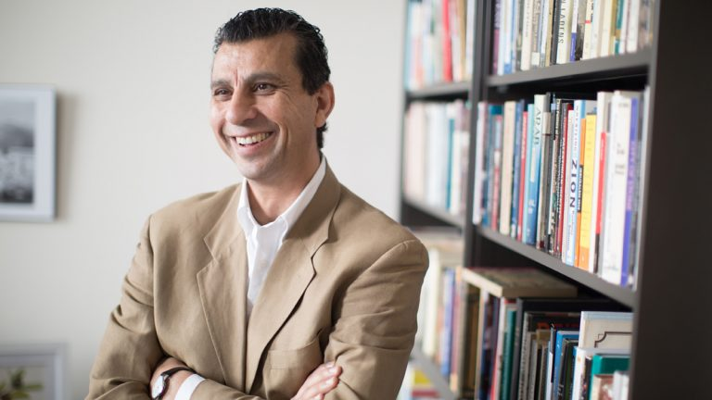
Informing Today’s Discourse on Immigration

Slide 20
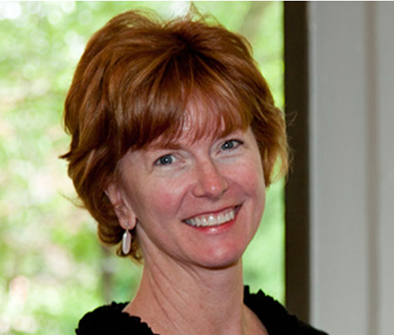

Pilot Project Offers Blueprint for Addressing Mental Health Needs of Homeless Children

Slide 21
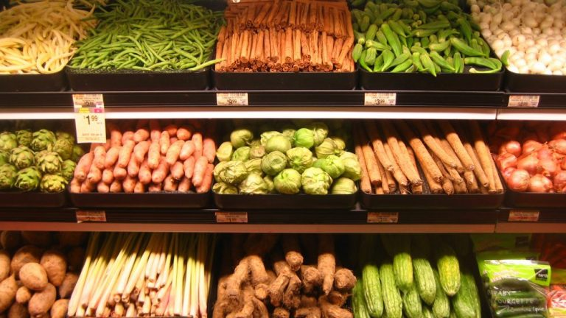
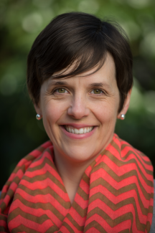
Money, Not Access, Key to Resident Food Choices in ‘Food Deserts’

Slide 22
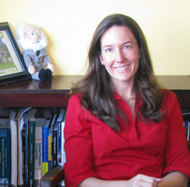

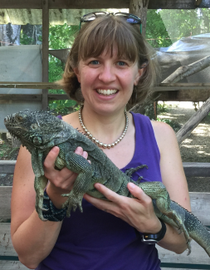
How Critical Thinking in the Humanities Reduces Belief in Pseudoscience

Slide 23
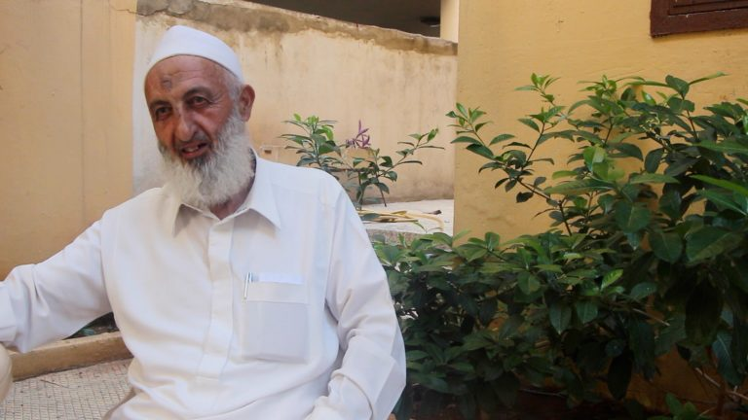
Student’s Documentary Captures ‘Common Link’ Between Us: Humanity
Laila Knio's The Common Link

Slide 24
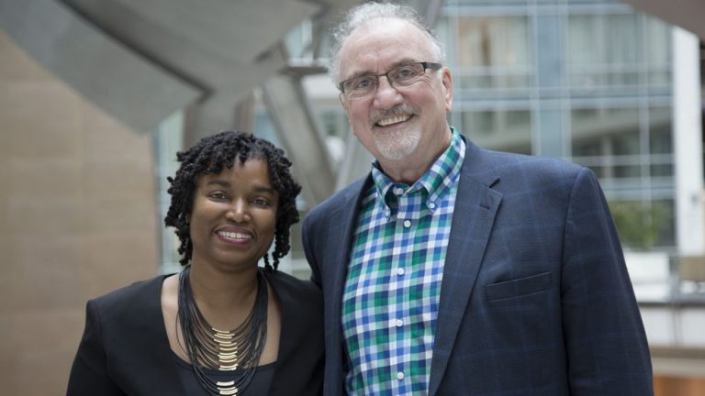
Talking Black in America

Slide 25
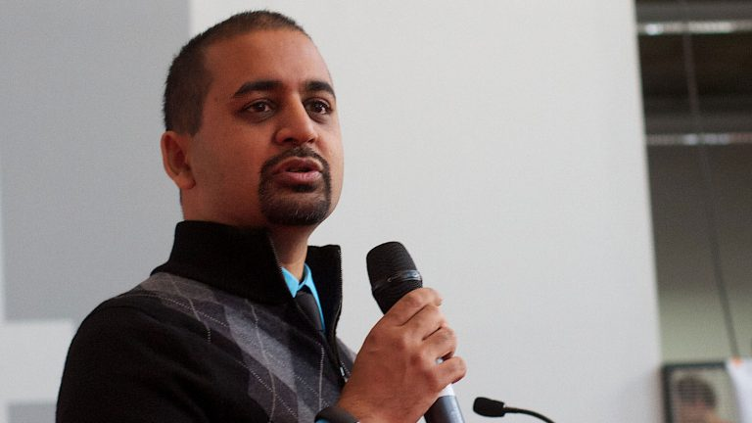
Anil Dash
Toward an Ethical, Inclusive Tech Industry

Slide 26


